Slide 1
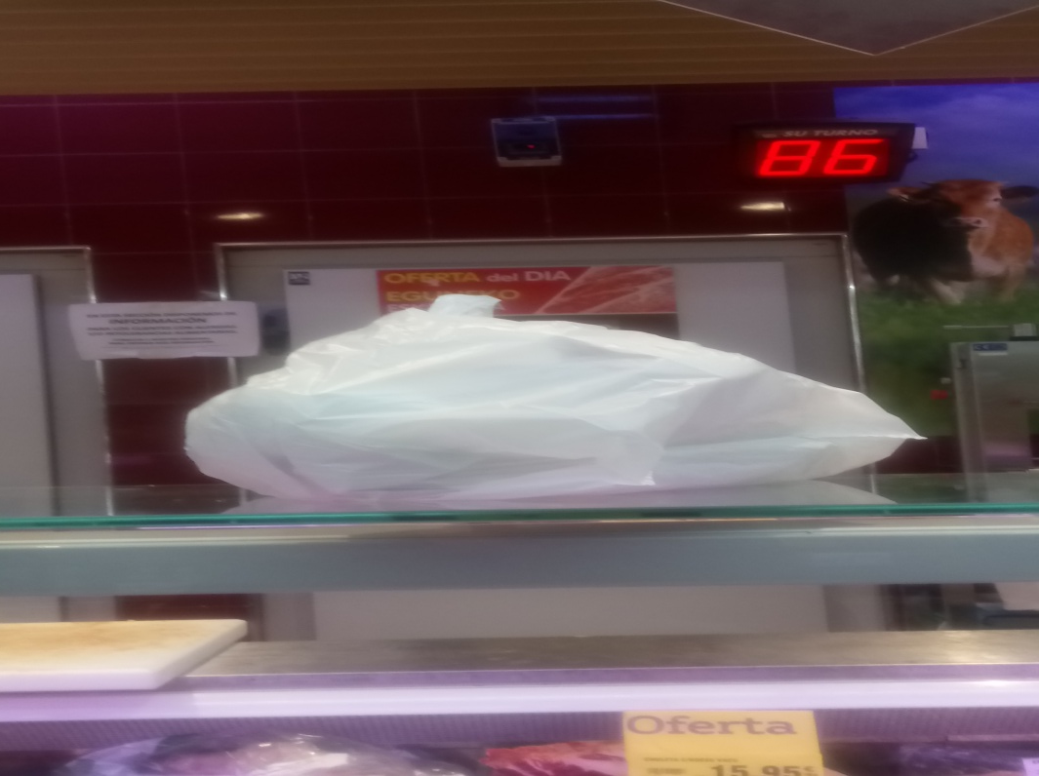
PLASTIC BAGS PROHIBITION
The goverment has forbidden the use of plastic bags because they are polluting the enviroment.

Slide 2
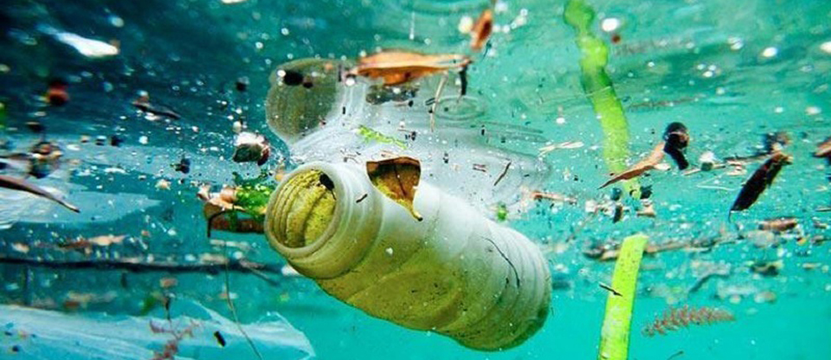
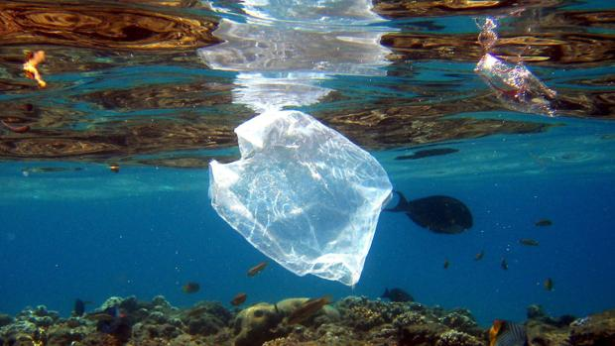
HOW LONG DOES IT TAKE FOR A PLASTIC TO DISSOLVE IN THE WATER?
A plastic takes 400 years to dissolve in the water.

Slide 3
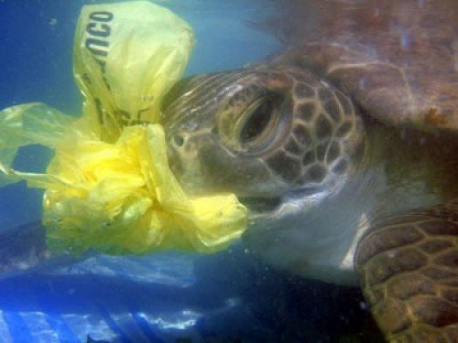
WHY??????
Because the turtles eat the plastics believing that they are fish.

Slide 4
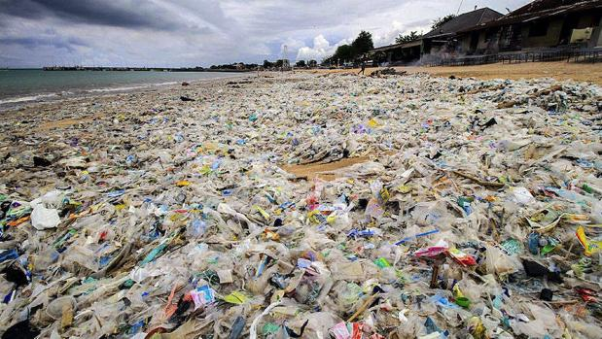
HOW DO WE kNOW THAT THE PLASTIC BAGS ARE POLLUTING?
We have known that the plastics are polluting the enviroment after long inestigation

Slide 5
WE ARE GOING TO USE THE SHOPPING CART.
Now in the basque country we are going to use the shopping carts instead of the plastic bags.

Slide 6
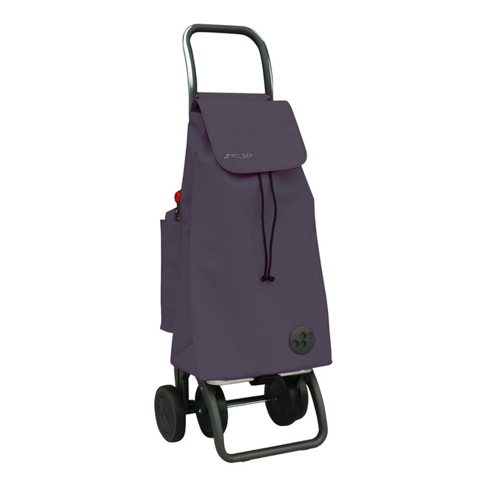
SHOPPING cart

Slide 7
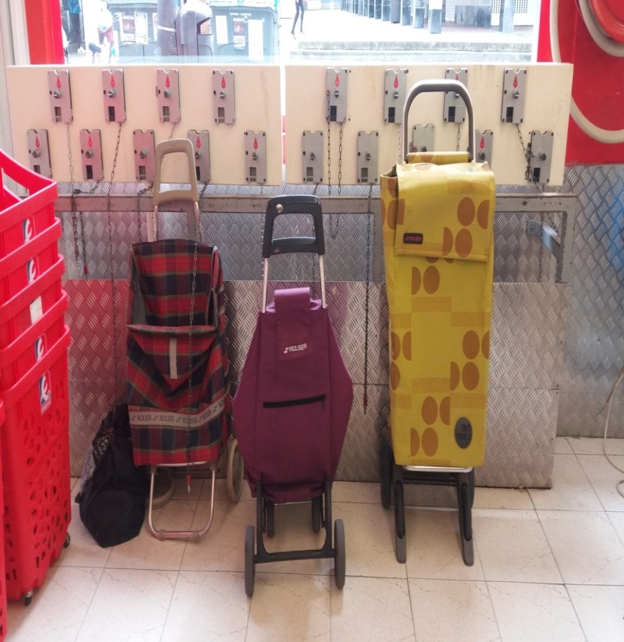
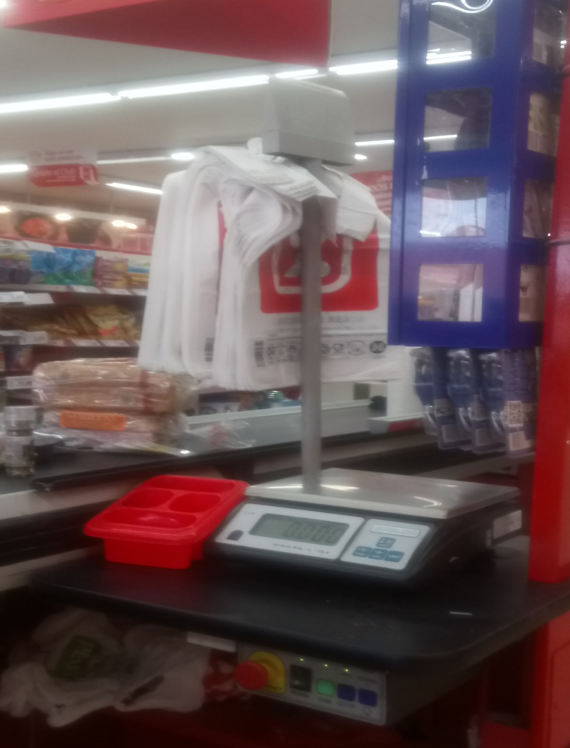
GREEN IN BERMEO
Notes:
WE ARE A BEST

